Slide 1
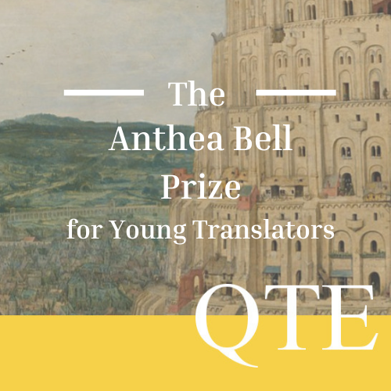



Slide 2
Competition Timeline
February 8th: Competition Opens.
April 3rd: Submission Deadline.

Slide 3
Accessing the Resources
On the Resources Page you will find links to Padlets for:
  One competition text for each level and language (no choice of genre).
  Practice texts for all levels, languages and genres (Fiction, Non-Fiction, Poetry).
The resources can be unlocked once registered for the Prize, with password:
    poemtranslateQTE22

Slide 4
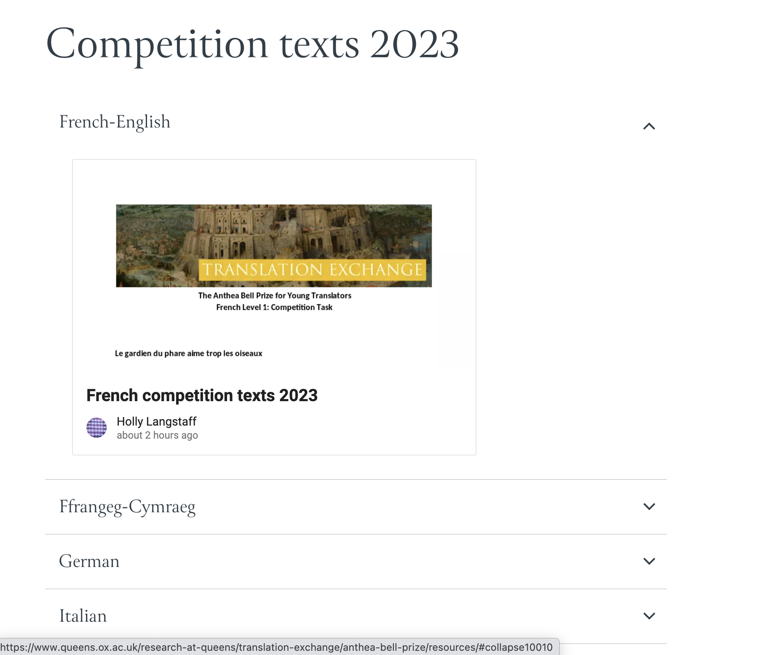
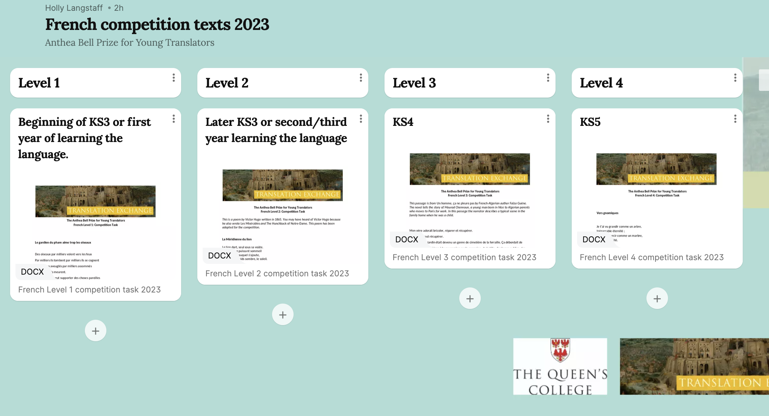

Slide 5
Levels
Level 1: Early KS3 or First year learning the language
Level 2: Later KS3 or second/third year learning the language.
Level 3: KS4
Level 4: KS5
Students should enter for the level at which they feel comfortable.

Slide 6
Running the competition
Set the translation as homework or in the classroom.
Run a lunchtime, afterschool or online translation club.
Set it as a holiday task

Slide 7
Running the competition
You can continue to use the practice resources in class before setting the competition text.
Students should receive no assistance from parents or teachers.
Students are welcome to use dictionaries and online resources.
Students may deviate from the glossary provided on the resources.

Slide 8
Running the competition
Students can work in pairs, but no more.
Students may illustrate their entries, but is in no way obligatory.

Slide 9
Submissions
Schools may enter in as many languages and levels they wish.
Only the top 5 entries from each level, in each language, should be submitted.
The maximum number of entries per school is 20.
The deadline is Monday 3rd April 2023.

Slide 10
How to submit
This year submissions will be accepted via an online form.
We will be in touch when the platform is ready.

Slide 11
Judging
Oxford languages undergraduates and professional translators will judge the entries over several stages.
Translations will be judged on the balance between creativity and accuracy.
Winners and commendees per geographical area are selected per level and language.
National winners and runners-up are selected from the Area winners.

Slide 12
Prizes
Area winners and commendees will receive a certificate.
UK-wide winners will receive a book as well as a certificate.

Slide 13
Feedback
We would appreciate all feedback regarding our resources.
Please make a note of what works and what doesn’t, and leave all comments at the following link:
https://www.queens.ox.ac.uk/research-at-queens/translation-exchange/anthea-bell-prize/anthea-bell-prize-feedback-for-teachers/

