Slide 1
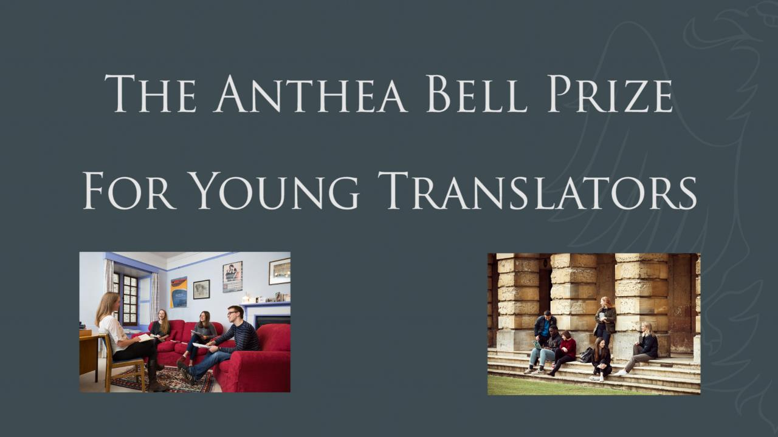
Notes:
The lesson starts with a 10-minute video to introduce the competition, featuring a professional literary translator, two students currently studying languages at The Queen’s College, and Director of the Translation Exchange Charlotte Ryland. Teachers with more time available may choose to break up the video to ask students what they remember and what impressed or surprised them.

Slide 2
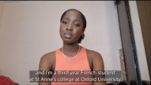
Notes:
10 minutes
https://www.youtube.com/watch?v=Kd-Q_-4UQ1U
You could pause video after each speaker to ask students to summarise what students have heard or to ask if there was anything they found surprising in that section of the video.

Slide 3
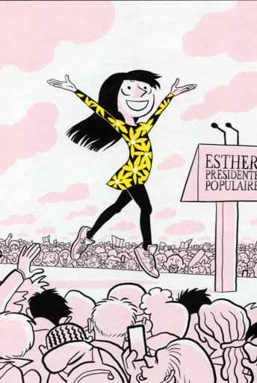
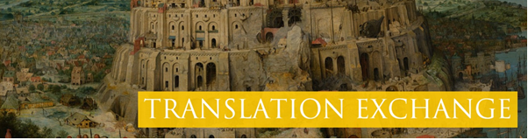
Les Cahiers d’Esther
Histoires de mes 12 ans by Riad Sattouf
Published by Allary Éditions
Notes:
Explain to students they are going to be translating an extract from a story about a girl called Esther and the stories of what happened to her
when she was 12 years old. Then introduce the starter task, telling students that they are going to practise telling their own stories first, before
they translate.

Slide 4
Starter activity…What’s YOUR story?
1. Tell the person next to you a (funny) story that happened to you lately. You only have 1 minute! (swap after 1 minute)
2. Now, imagine that the other person is your school headmaster/headmistress, and tell your story again (1 minute each). Be honest, and really try to use a more respectful tone to address your headmaster.
3. Let’s discuss :
Did you tell the story the same way both times?
If not, what changed?
Which specific words or expression did you change? Write them down on your worksheet.
Notes:
Starter task: You can ask the students to share some responses with the class, and focus on the reasons why different people use different expressions:
Which expressions are more formal/informal?
Which expressions are associated with specific age groups?
Which expressions are local/regional?

Slide 5
Researching the text
The text we’re going to translate today uses lots of informal vocabulary.
To help us decide how to translate these words, we need to research the text.
Using the information on your worksheet, can you identify:
What type of book is it?
Who/what is it about?
Who is the target audience?
What is said in the reviews about the tone and register it use?
Write down your findings on your worksheet, then compare them with the person next to you.
Notes:
Ask students to complete the task and take some brief feedback. To reduce the time spent and create more time for translating, you could ask half the class to work on questions 1 and 2 and the other to work on questions 3 and 4, and then conduct your feedback session.

Slide 6
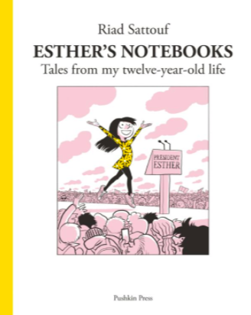
Esther’s Notebooks
by Riad Sattouf
published in France by Allary Editions
Series 1-3 translated by Sam Taylor & published in English by Pushkin Press (2021)
From the blurb:
“Every week, the comic book artist Riad Sattouf has a chat with his friend’s daughter, Esther. She tells him about her life, about school, her friends, her hopes, dreams and fears, and then he works it up into a comic strip.
This book consists of 52 of those strips, telling between them the story of a year in the life of this sharp, spirited and hilarious child. The result is a moving, insightful and utterly addictive glimpse into the real lives of children growing up in today’s world.”
Notes:
Additional context.
Once students have identified that the text is a graphic novel, the teacher may wish to elicit further information to help guide word choices when they approach the translation task: is it funny or sad - what adjectives are used to describe the book? Do you think it aims more to inform, or to entertain? Is it for young people or adults - or both? What makes you say this?

Slide 7
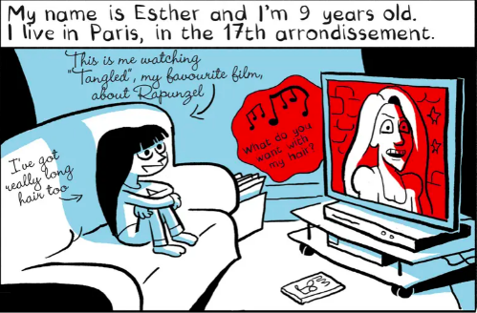
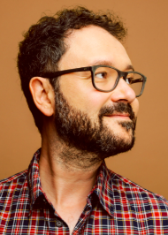
Additional context – reviews & author bio:
“These funny, well-observed comics are fantastically daring. They have so much to say about the experience of being a girl in a European city in the 21st century – and if not all of this makes for comfortable reading, it’s also what makes them indispensable. Fathers! You and your daughters should read them together.” – Guardian review by Rachel Cooke
About the author:
Riad Sattouf is a bestselling cartoonist and filmmaker who grew up in Syria and Libya and now lives in Paris. His autobiographical series The Arab of the Future has sold more than a million copies in France alone, won multiple prizes and been translated into sixteen languages. The Esther’s Notebooks series has also sold nearly 700,000 copies in France, been adapted for a popular animated TV series, and is being translated into 8 languages.
Notes:
Article source: The Guardian

Slide 8
How to translate
 | Step 1 | Step 2
Text to Translate | Word-for-Word | Polished Translation
 | First, we need to understand the text by translating each words using the glossary. | Second, we polish our translation, changing the word order and trying different words.
[Est-ce que vous êtes bien assis?] | [word for word translation]
Notes:
Explain to the class how to use the glossary to find the words they need.
Model literal translation first (the children find the words and the translator writes them down), then invite the children to suggest polished translations.

Slide 9
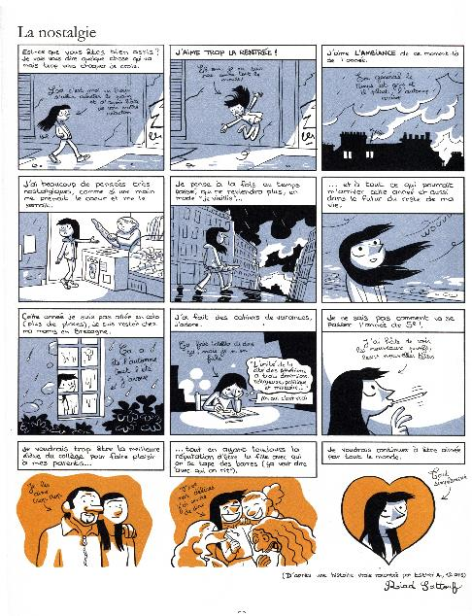
What extra things do you need to think about if you’re translating a graphic novel?
Different fonts and formats are used to indicate dialogue, Esther’s thoughts and Esther reporting to the author. Will this change the language you use?
You must make sure your translation is a similar length to the French, so it can fit into the speech bubbles
Notes:
Optional slide to be using during the translation phase.
Which words/phrases are the most challenging to translate? Why?
Do you disagree about how to translate any words/phrases?
Do you think anything is lost or gained in your translation?
Which translation solutions do you think work well?

Slide 10
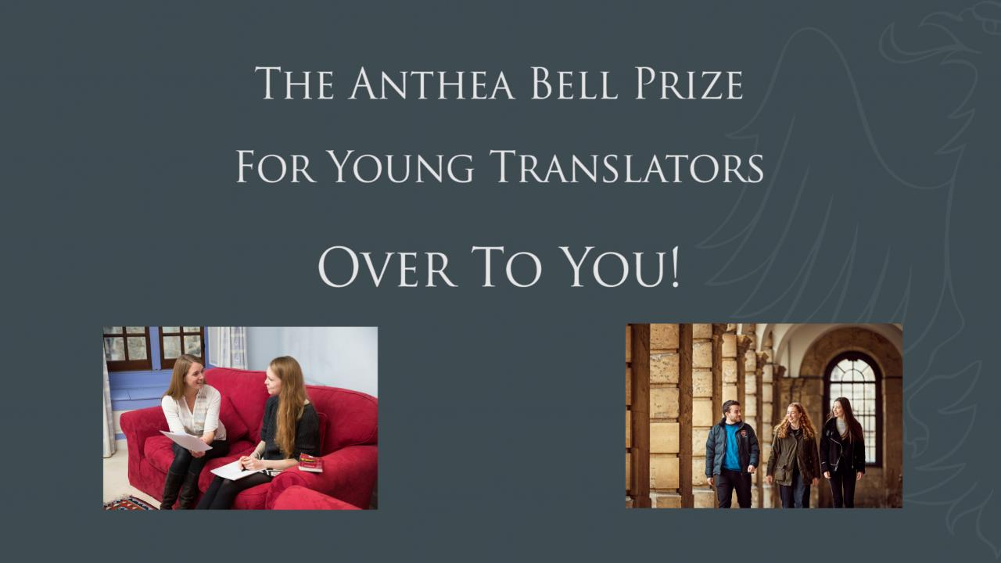
Notes:
Students can translate their extract in pairs, in groups of 8 OR alone, in groups of 4.
For a class of 30 you will need to be flexible with this. A suggested grouping would be 3 groups of 8 and one group of 6, with the group of 6
having two pairs and two students working individually.

Slide 11
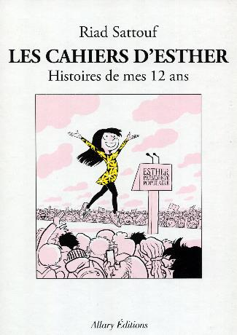
Comparing translations
Compare your translations with other people who translated the same extract. Can you identify your “favourite” versions?
Notes:
This task is optional, depending on time constraints. Ask students to walk around the room, reading the different translations. Encourage the students to choose their prefered translations within their class.

Slide 12
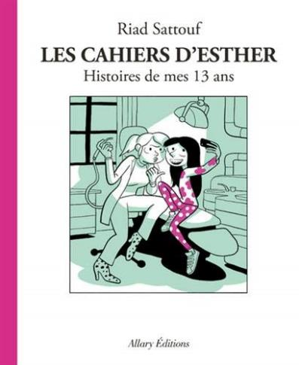
Creative Task:
Prepare a 3–5-minute reading for the YouTube Channel ‘Translators Aloud’ to encourage English-language publishers to translate the next book in the series.
You may want to:
Share some information about the book & author
Say who you think would/should buy the book
Give examples of similar books to spark viewers’ interest (e.g., ‘This will appeal to fans of...’)
Read aloud some of the French text before you read your translation
Notes:
Translators Aloud: https://www.youtube.com/channel/UCjaq9OSpoEeohPmK8ZT-C7w
The teacher may wish to begin by playing one of the shorter videos from the site as an example.
This task could be used in the following lesson, or set as an enrichment homework task for the students. This is also an excellent opportunity for students to practise reading some of the extract aloud and improving their pronunciation skills.

Slide 13
Presentation © Queen’s College Translation Exchange 2023
Cahiers d’Esther © Allary Editions
Designed by Kate Thirlwall

