Slide 1
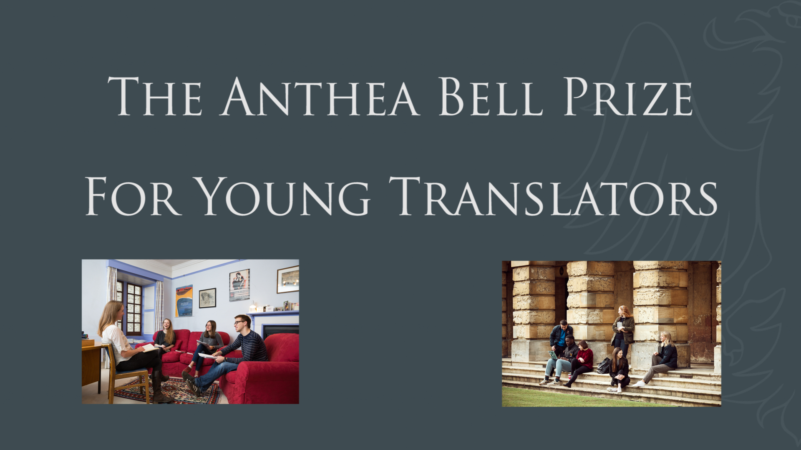

Slide 2
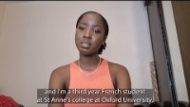
Notes:
10 minutes
https://www.youtube.com/watch?v=Kd-Q_-4UQ1U
You could pause video after each speaker to ask students to summarise what students have heard or to ask if there was anything they found surprising in that section of the video.

Slide 3
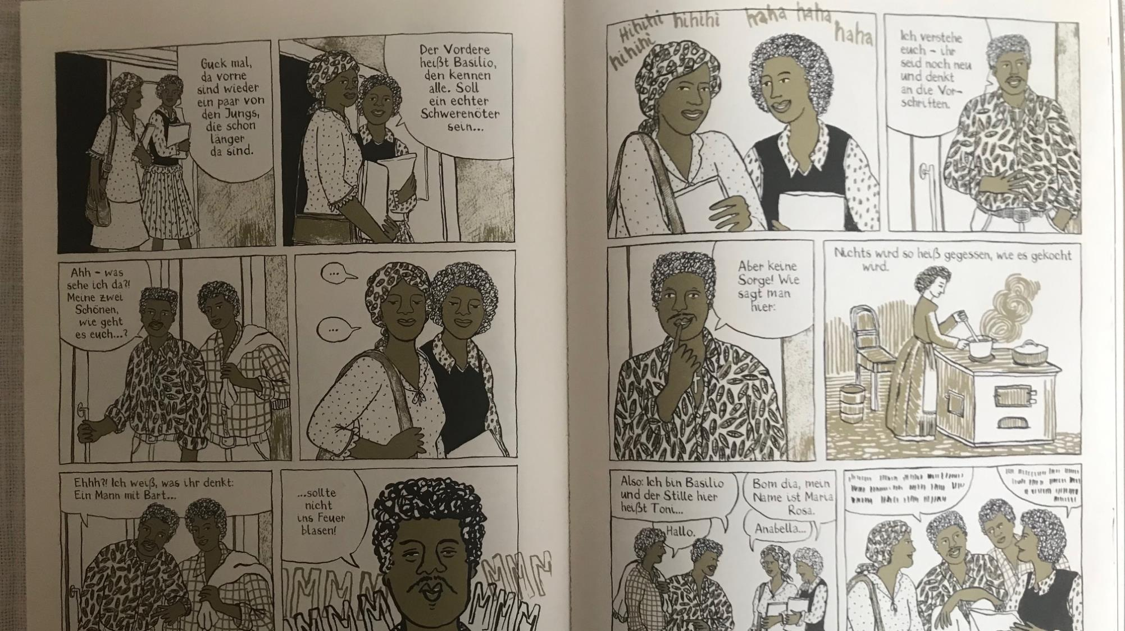
The text you’re going to translate today has lots of historical and cultural references.
To help us understand what is going on and decide how to translate the words, we need to research the text.
Using the information available to you, can you identify:
What type of book is it?
Who is the target audience?

Slide 4
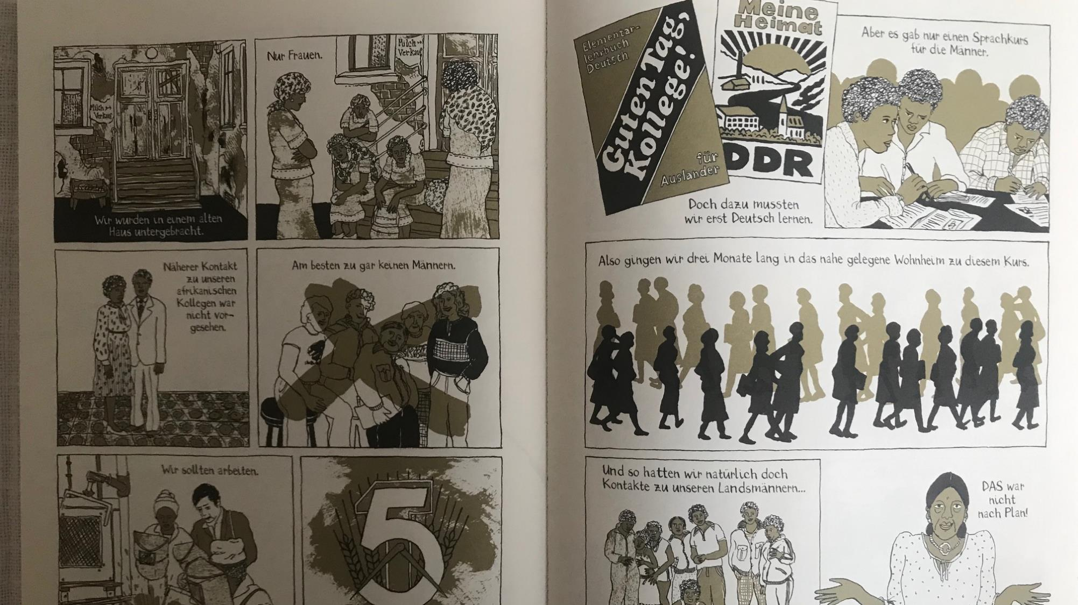
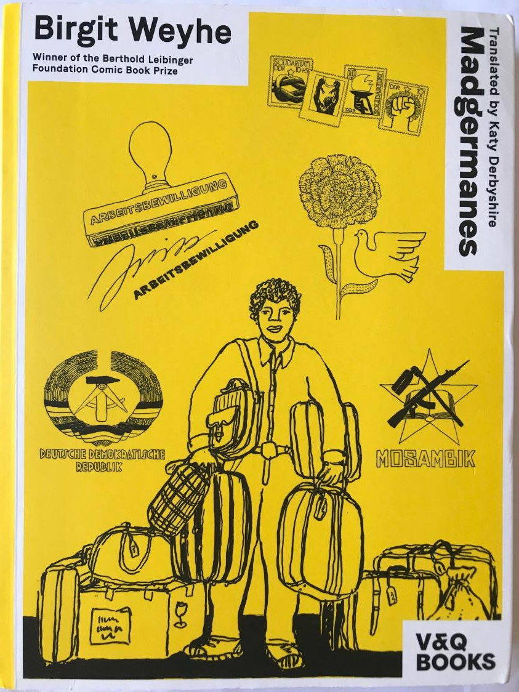
Schaut diese Bilder auf der Titelseite der englischen Übersetzung an.
Um was geht es in dieser Geschichte eurer Meinung nach?
Notes:
Madgermanes by Birgit Weyhe, translated by Katy Derbyshire.
Link to the English translation of Madgermanes: https://vq-books.eu/wppb_works/madgermanes/
The stamps could be pointed out to the students, in particular the 4th one across with the clenched fist marked ‘Internationale Solidarität’ indicating the unity between Communist GDR and socialist states in Africa.

Slide 5
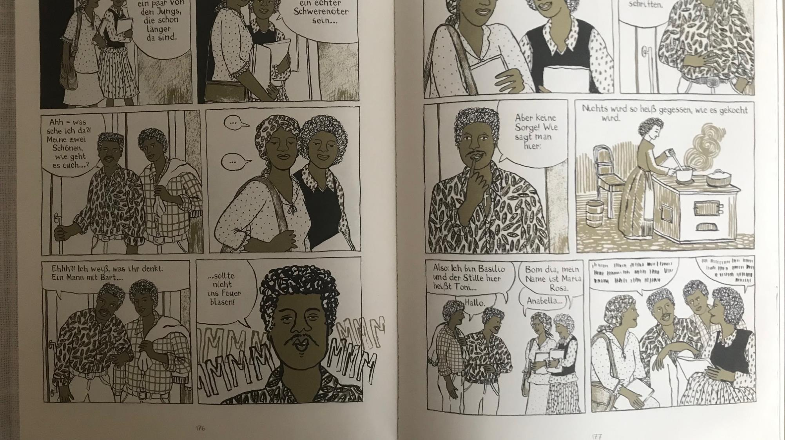
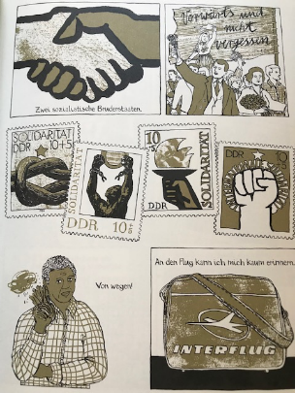
East German stamps
showing unity (Solidarität) between communist GDR
and socialist states in Africa. ‘Zwei sozialistische Bruderstaaten’
Arbeitsbewilligung
Deutsche Demokratische Republik
= German Democratic Republic (GDR) {former East Germany 7 Oct 1949 - 9 Oct 1990}
Mosambik
Portuguese colony 1498-1975.
War of Independence 1964 - 1975.
The Front for the Liberation of Mozambique (FRELIMO) took control of Mozambique in 1975
and established a one-party state.
Shortly after independence, civil war broke out between the opposition forces of anti-communist Mozambican National Resistance (RENAMO) rebel militias and the FRELIMO regime. Civil war lasted from 1977-1992.
Notes:
Information about Mozambique from Wikipedia: https://en.wikipedia.org/wiki/Mozambique

Slide 6
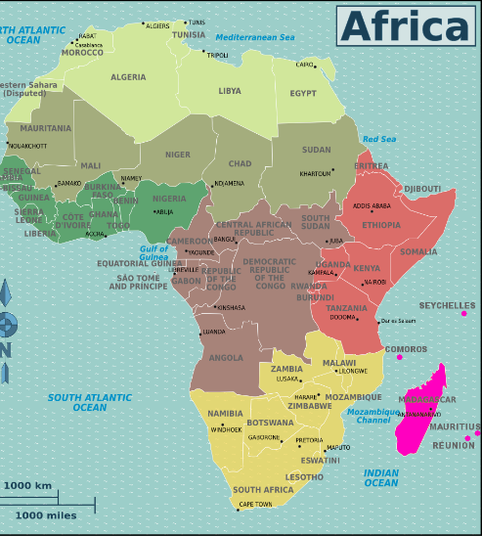
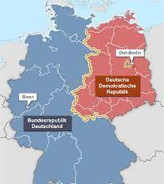
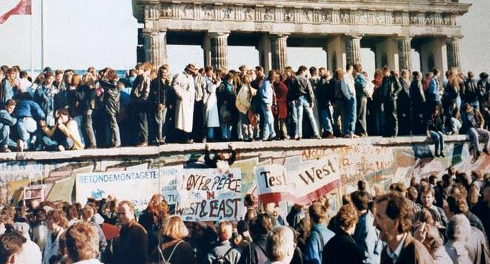
Mit ’Madgermanes’ hat Birgit Weyhe deutsch-afrikanische Geschichte aufgearbeitet. Das Comic-Buch beeinhaltet drei fiktive Biographien, die sich an realen Ereignissen inspirieren.
Teil einer Buchrezension des Goethe-Instituts: -
‘Birgit Weyhe
INSPIRATION, PROTEST AND PICTURE POLITICS …
…Madgermanes nennen sich in Mosambik diejenigen, die Ende der Siebziger als Vertragsarbeiter ins sozialistische Bruderland DDR kamen, wohl um die 20.000 Menschen. Mit dem Zusammenbruch der DDR erlosch ihre Aufenthalts- und Arbeitserlaubnis. Die meisten gingen zurück in die Armut des inzwischen vom Bürgerkrieg verwüsteten Mosambik, wo ihnen ihre Berufe nichts nützen und sie bis heute auf einen Teil ihrer Löhne warten.…’
English version
Notes:
This slide is intended to give some historical context to help students understand why Anabella has moved to East Germany and what she is doing there.
The review from the Goethe-Institute can also be read in English here: https://www.goethe.de/ins/us/en/kul/bks/cad/21560894.html
Images from top left: 1. “Map Africa Regions Islands.png” by Nick Roux and Peter Fitzgerald
is licensed under CC0 1.0 Universal Public Domain Dedication. 2. “Karte Innerdeutsche Grenze” by Alexrk2 is licensed under CC BY-SA 3.0. 3. “Fall of the Berlin Wall” by Gavin Stewart under CC BY 2.0.

Slide 7
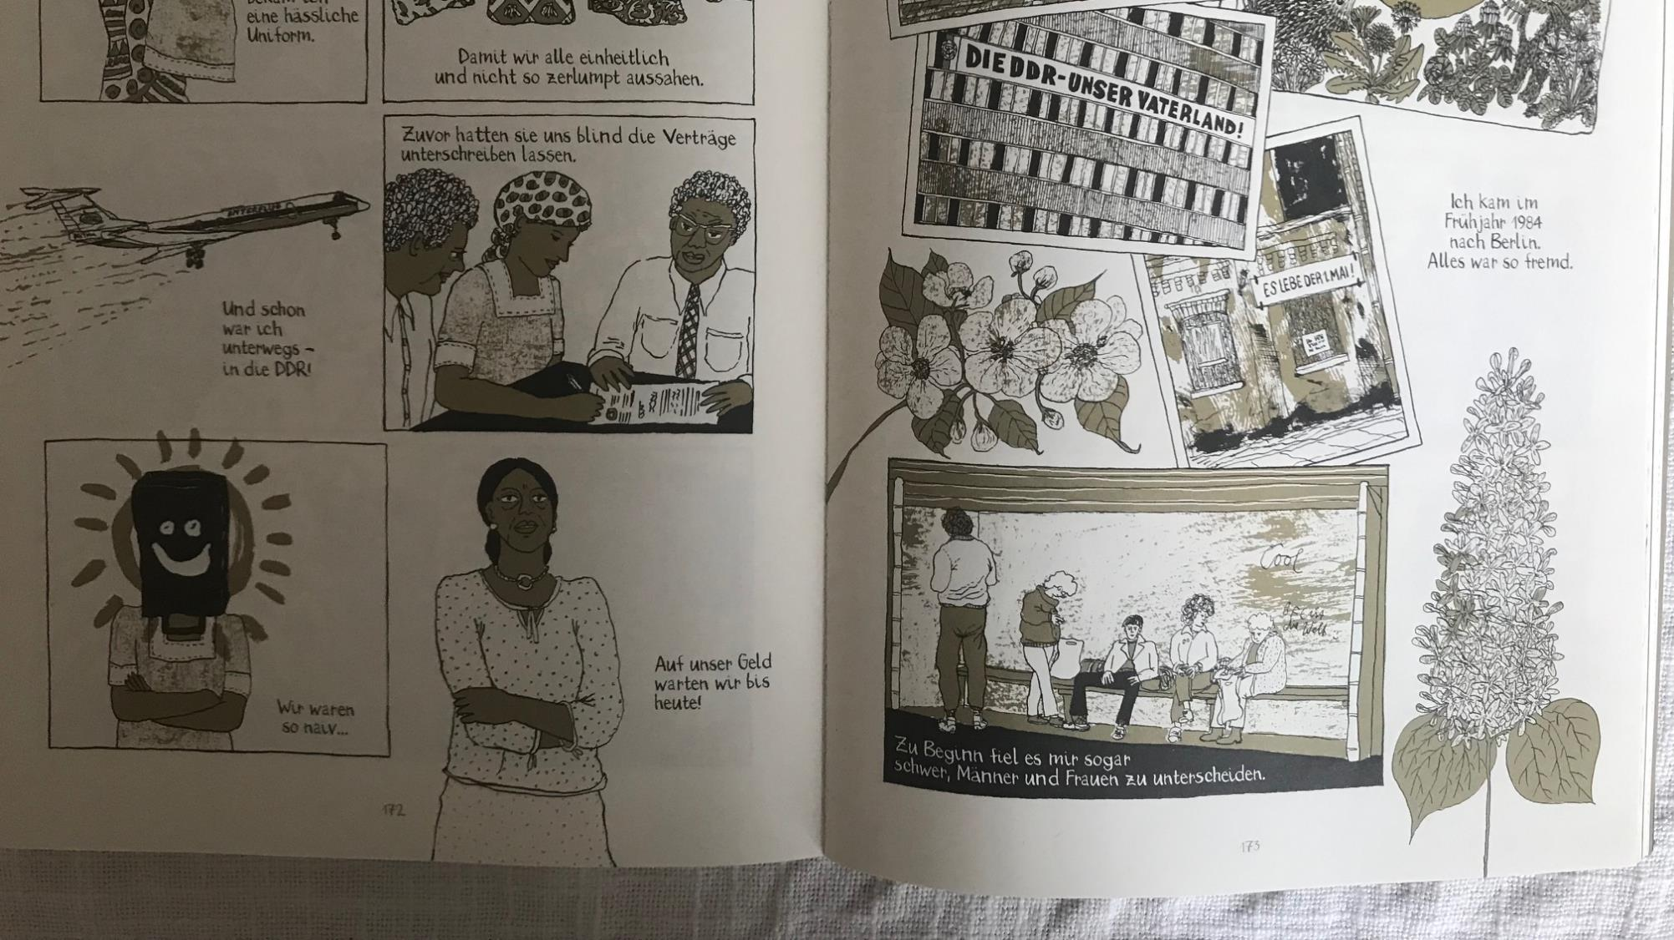
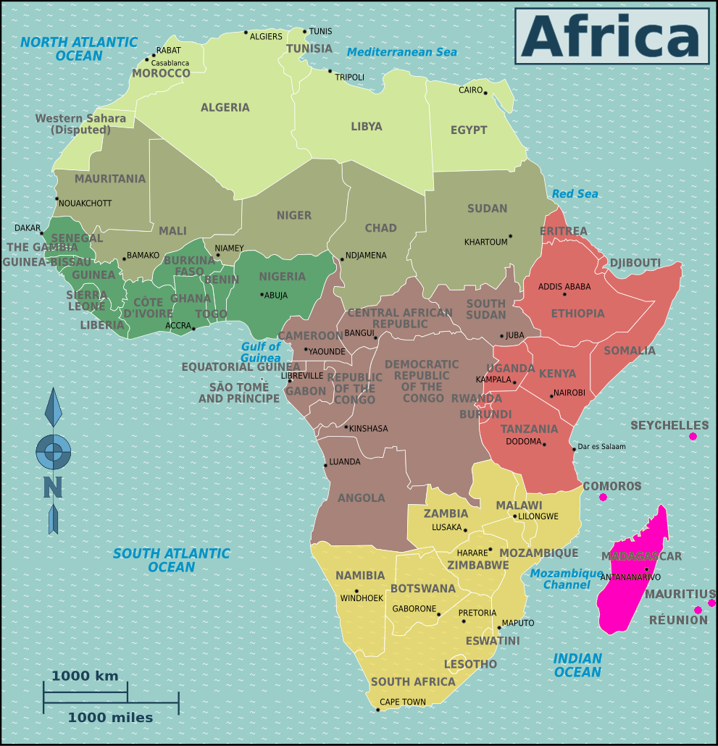
Die Protagonisten stammen aus Mosambik. Welche Sprachen werden in Mosambik gesprochen?
Einer der Protagonisten sagt „Bom Dia“. Welche Sprache ist das and was heißt es?
Die Hauptstadt von
Mosambik ist Maputo.
Notes:
Which languages are spoken in Mozambique? See https://translatorswithoutborders.org/language-data-for-mozambique#:~:text=Portuguese%20is%20the%20country's%20official,Sena%2C%20Chwabo%2C%20and%20Tswa.
There are over 40 languages spoken in Mozambique. Portuguese is the country's official language, but it is only spoken by around half of the population. The other most spoken primary languages in Mozambique, include: Makhuwa, Changana, Nyanja, Ndau, Sena, Chwabo, and Tswa.
Does anyone speak any of these languages?
Why do you think they speak Portuguese?
Image “Map Africa Regions Islands.png” by Nick Roux and Peter Fitzgerald
is licensed under CC0 1.0 Universal Public Domain Dedication.

Slide 8

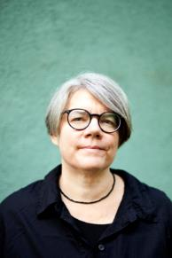
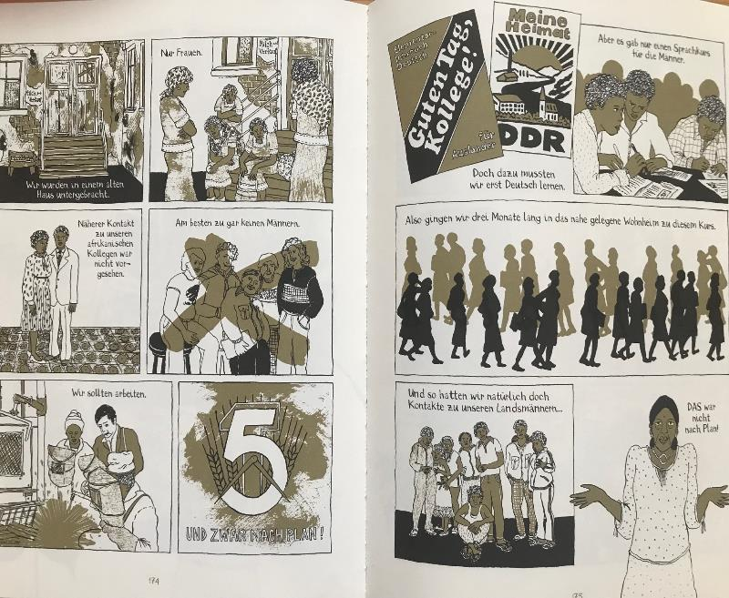
Additional context
About the author: Birgit Weyhe is a German cartoonist and illustrator who spent her childhood in East Africa and now lives in Hamburg. ‘Madgermanes’ won the 2015 Comic Book prize of the Berthold Leibinger Foundation and the 2016 Max und Moritz Prize for the best German Comic.
https://birgit-weyhe.de/about-me/
Quote from a review by Anna Blasiak in the European Literature Network (ELN)
‘I might have grown up in communist Poland, and in fact not far from the border with what was then East Germany, but I had never heard about the scheme that this graphic novel describes – bringing people over from Mozambique to East Germany to provide what essentially amounts to slave labour.’
Arte Journal:
‘Madgermanes –
Comiczeichnerin Birgit Weyhe
ausgezeichnet’:
video report 2 mins 51
‘Madgermanes’, by Birgit Weyhe published by Avant Verlag 2016
Notes:
Arte Journal video report in German gives an overview of what happened to the Mozambican contract workers and includes footage of Birgit Weyhe at work in her studio and an interview with her. Students could be asked to describe the culture shock the contract workers experienced on arrival in East Germany. The following vocabulary is from the video (in the order in which it appears) and may help students understand the report when viewing:
(der Vertragsarbeiter = contract worker, gleichberechtigt adj = equal, der Ausgehverbot = curfew, verordnen = to prescribe, order, bröckeln = to crumble, die Fratze = grimace, hideous face, die Vorsorge = provision
die Entwurzelung = uprooting, die Sehnsucht = longing, yearning, die Anerkennung = recognition).
Suggested prompt questions: what kind of book is it? how would you describe it? Is it aimed more to inform, or to entertain? What makes you say this? Is it for young people or adults or both?
https://birgit-weyhe.de/about-me/
https://www.eurolitnetwork.com/rivetingreviews-anna-blasiak-reviews-madgermanes-by-birgit-weyhe/
Arte Journal: https://www.youtube.com/watch?v=W2XepU5lIjE

Slide 9
Time to Translate!
A reminder of some important things to keep in mind when translating:
Word-for-word (‘literal’) translations aren’t always your best option: replacing one word in German for an equivalent English word can result in nonsense.
Translators have to be creative: it is your job to make the translation sound like it was written in English – translators are creative writers as well as readers.
Translation is about meaning, not just words, so you have to think about what sort of mood or meaning is conveyed in the original and try to recreate that in your translation.

Slide 10
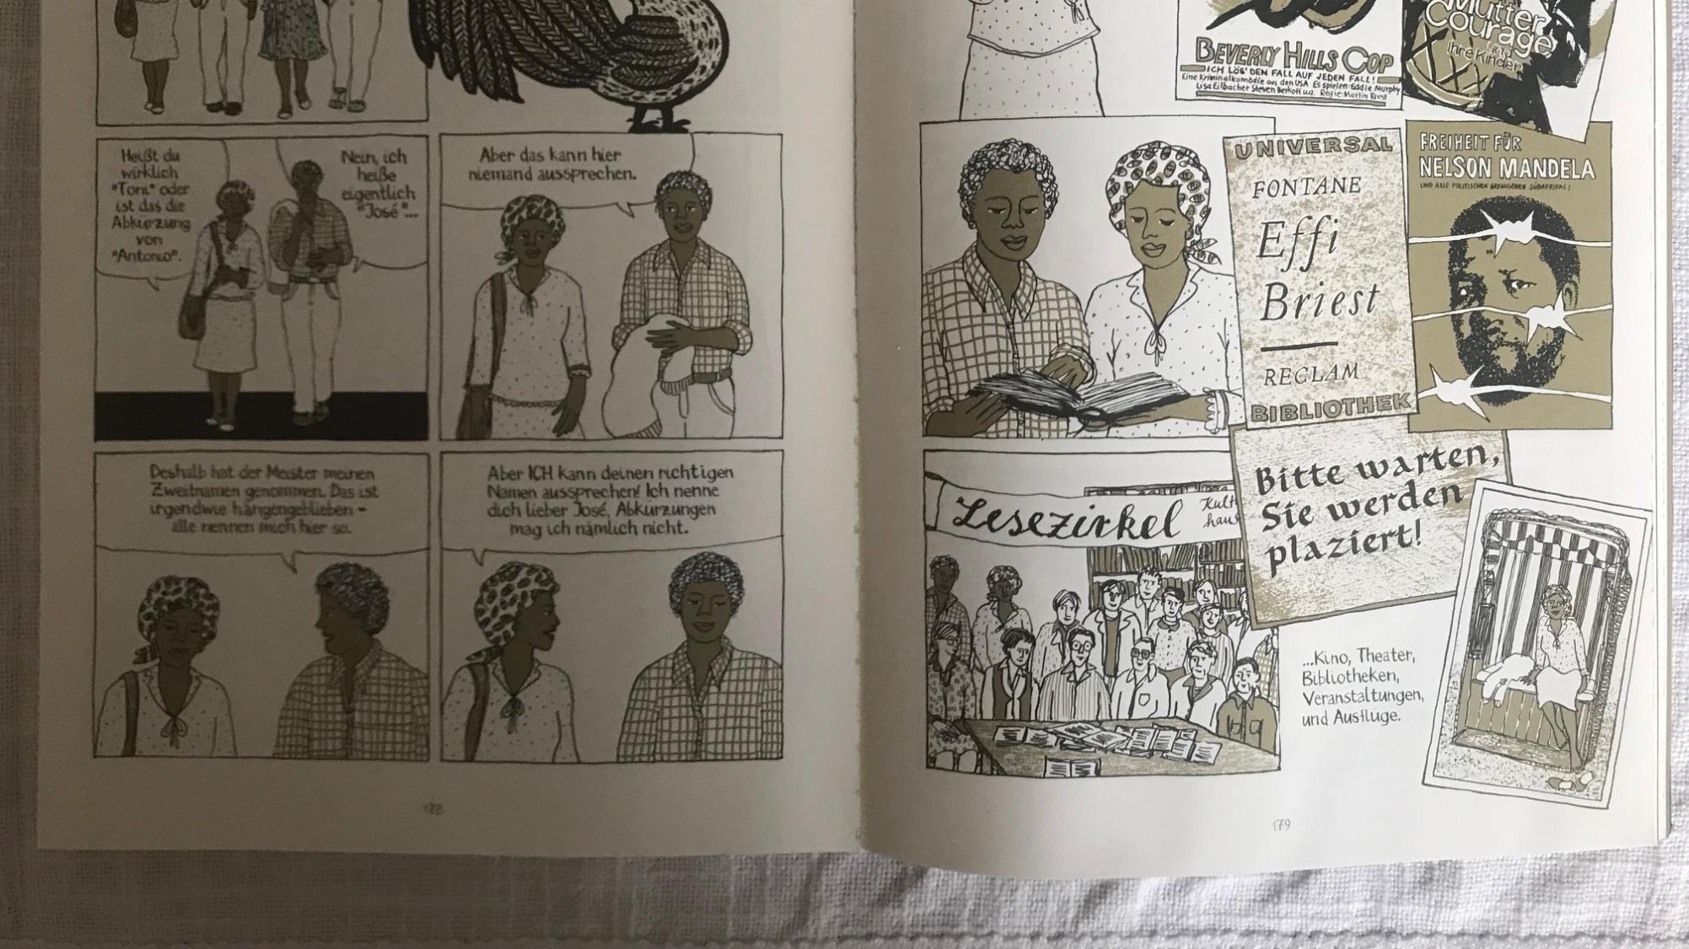
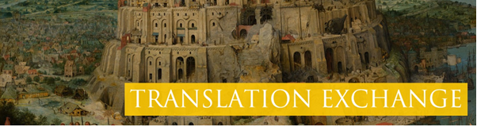
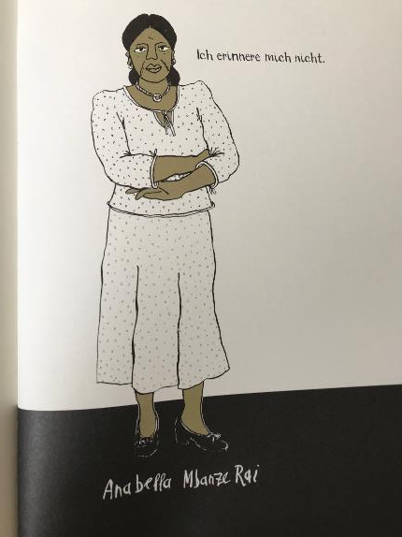
Project brief:
Translate a passage from Anabella’s story in the book ‘Madgermanes’. It is 1984 and Anabella has just arrived in East Germany.
Using a dictionary or the glossary provided, draft a literal (word-for-word) translation of the text.
Edit your translation so that it appeals to your target audience and reflects the features you have identified in your research.

Slide 11
1. Using a dictionary or a glossary, draft a literal (word-for-word) translation of the text.
E.g.: Ich verstehe euch
I understand you
2. Edit your translation so that it appeals to your target audience and reflects the features and tone you have identified in your research.
E.g.: I see where you are coming from
I get the picture
OK, I get it
I got ya!
Got it…
Notes:
Students could be asked to think about what expressions are more formal/informal? Which expressions are associated with specific age groups?

Slide 12
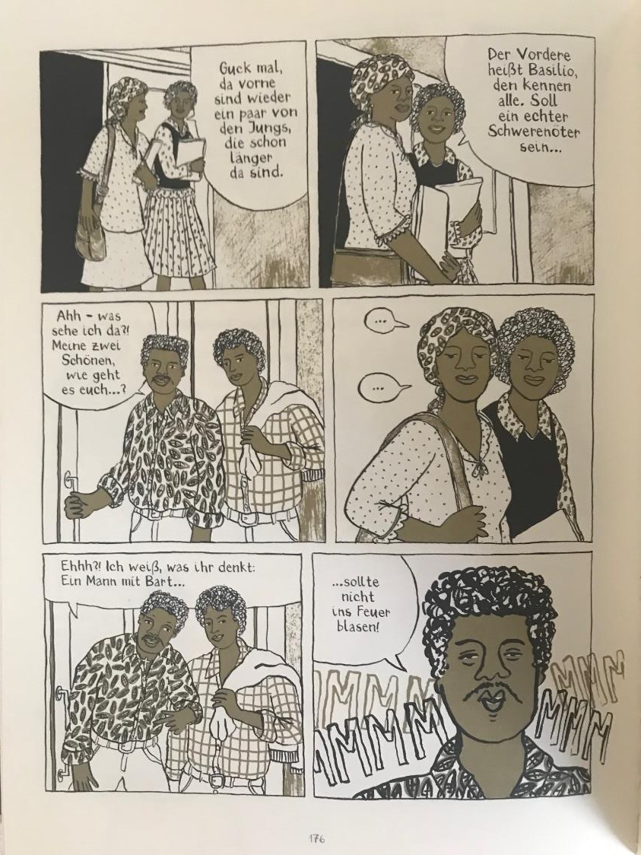
What extra things do you need to think about if you’re translating a graphic novel?
Events in Anabella’s story take place in the 1980s.
Are you going to use expressions popular in the 1980s or ones you might use now?
You need to make sure your translation is a similar length to the German, so it fits in the boxes/speech bubbles of the original.
Notes:
Which words/phrases are the most challenging to translate? Why?
Do you disagree about how to translate any words/phrases?
Do you think anything is lost or gained in your translation?
Which translation solutions do you think work well?

Slide 13
The 3 Stages of a Creative Translation
READ
Read through the text and mark any unknown vocabulary.
Does anything unusual stand out?
INTERPRET
What is happening in the passage? How would you describe the mood?
Are there any important sounds or images?
CREATE
Now edit your translation to recreate the effect of the original.
Try translating the passage literally (replacing word for word).
What mood are you trying to convey?
Read through your translation without the original to check it sounds natural.

Slide 14
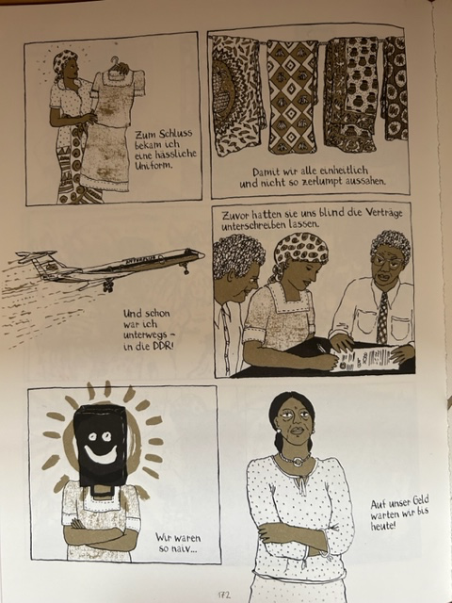
On this page, Anabella is reflecting on her move from Mozambique to East Germany? How does she feel about it? How can you tell this?
‘Madgermanes’, by Birgit Weyhe published by Avant Verlag 2016

Slide 15
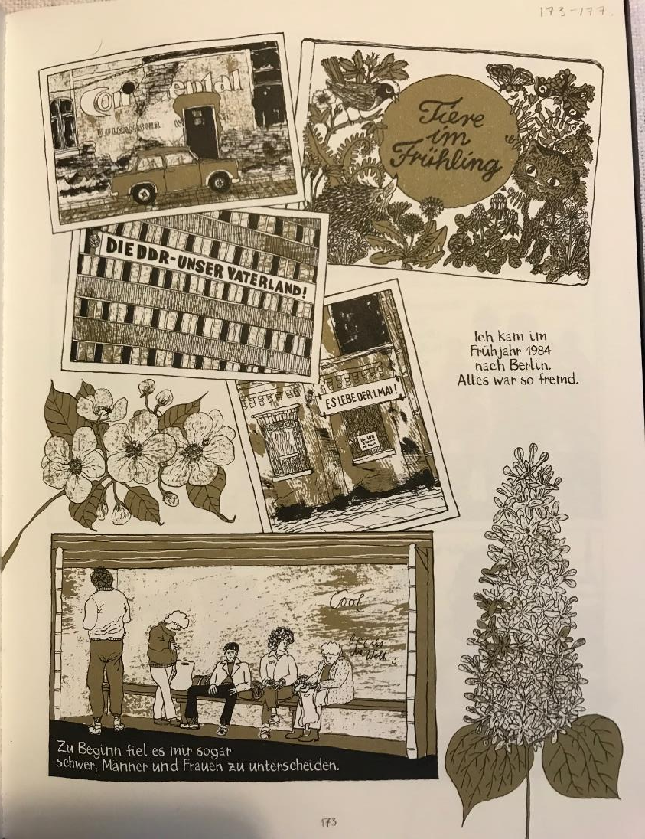
Look at the images of East Germany. Do they help to set the scene?
What was different for Anabella?
‘Madgermanes’, by Birgit Weyhe published by Avant Verlag 2016
Notes:
‘Madgermanes’, by Birgit Weyhe published by Avant Verlag 2016

Slide 16
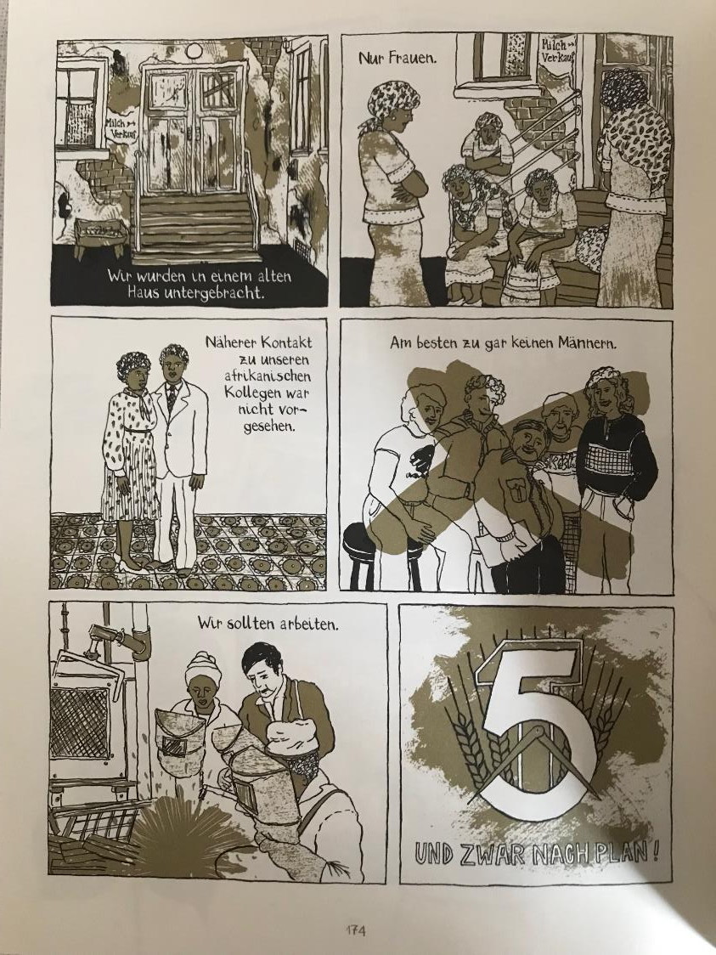
Why were women treated like this?
Whose plan is this?
Notes:
‘Madgermanes’, by Birgit Weyhe published by Avant Verlag 2016

Slide 17
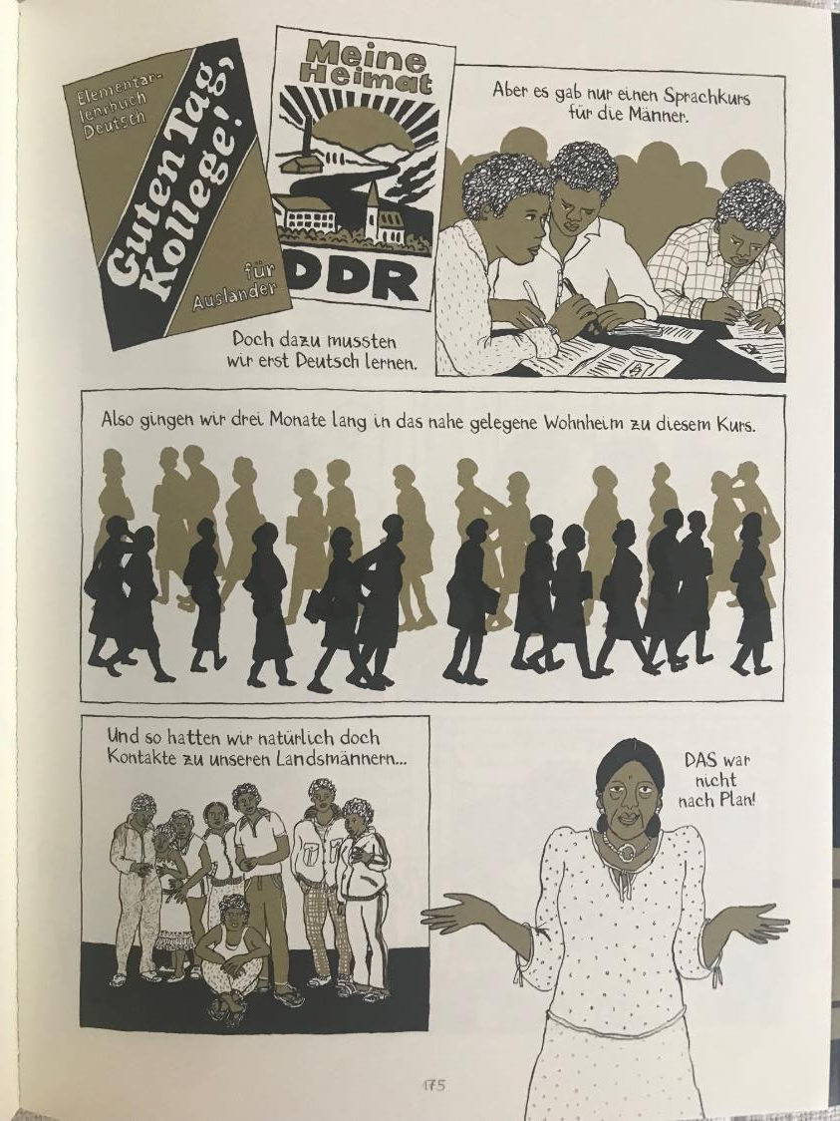
Why would this be the case?
Notes:
‘Madgermanes’, by Birgit Weyhe published by Avant Verlag 2016

Slide 18
What do you think Basilio means here? Would you translate this word for word or is there another way of saying it in English? Do you think it might be translated from a saying used in Mozambique?
Notes:
‘Madgermanes’, by Birgit Weyhe published by Avant Verlag 2016
Suggested prompt: do you think he is trying to be funny?

Slide 19
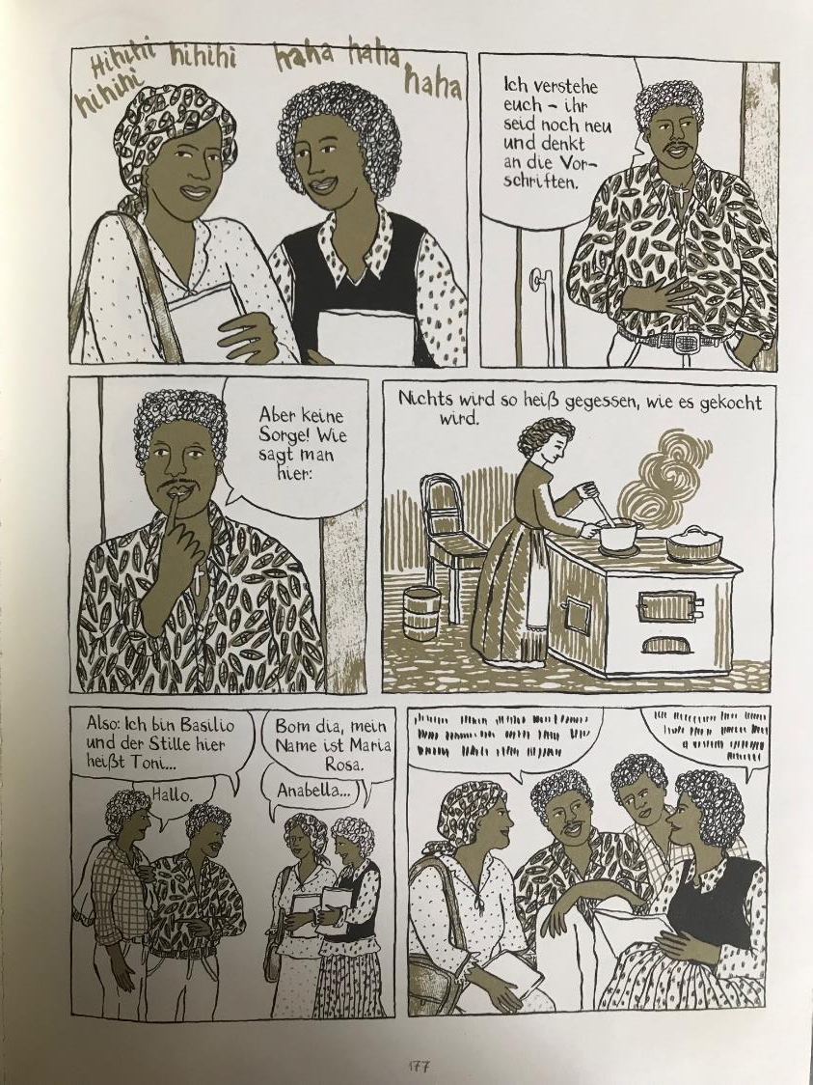
Think about whether you would translate this word for word, or is there another way of saying it in English which means the same thing?
Maria Rosa greets Basilio and Toni in Portuguese. Will you translate ‘Bom Dia’ or leave it in Portuguese?
What might they be saying to each other?
Notes:
‘Madgermanes’, by Birgit Weyhe published by Avant Verlag 2016

Slide 20
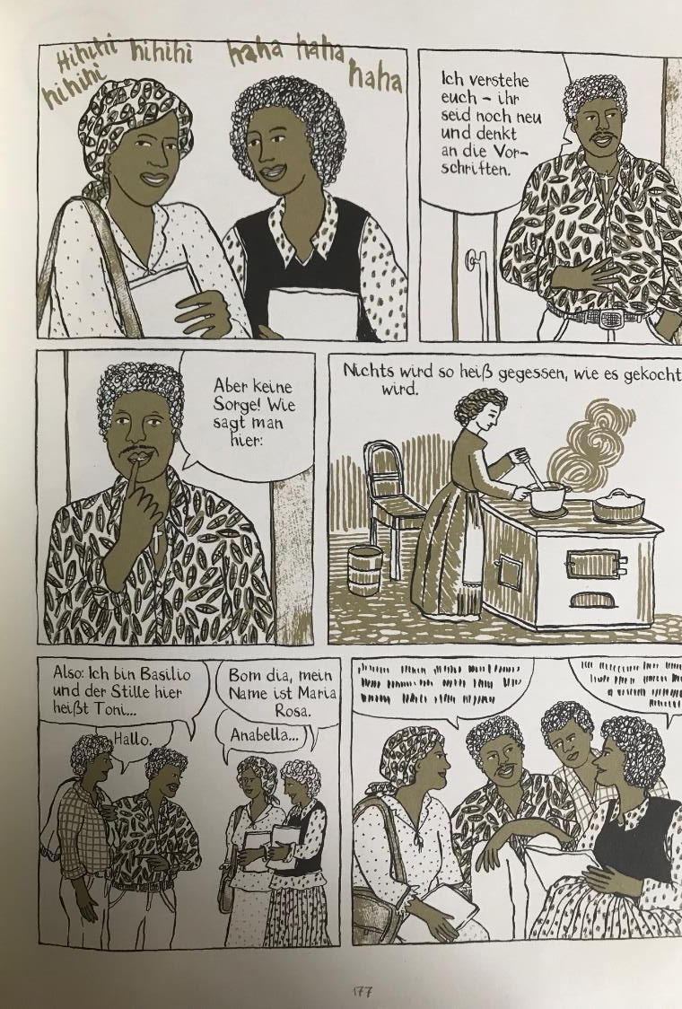
Extension activity
Click here to listen to a video recording of an interview with Birgit Weyhe made by The Queen’s College Translation Exchange.
On the following slide you will see the questions in English Birgit Weyhe was asked. Choose one of the questions. Listen to what Birgit Weyhe says in German and summarise her answer in English.
Notes:
If time is short, students could listen to Birgit Weyhe’s concluding remarks at 06:51 – 07:21 and discover what the word Madgermanes means and where it comes from.

Slide 21
Queen’s College Translation Exchange: Interview with Birgit Weyhe
Total running time 07:21 mins
1. 00:06 – 00:17 Birgit Weyhe introduction
2. 00:18 – 01:42: Can you tell us more about your personal reasons for exploring the plight of the ‘Madgermanes’?
3. 01:43 – 02:31: What language(s) did you use to conduct the interviews? Did you use interpreters at all and if so, what were the challenges?
4. 02:32: 04:35 What surprised you that came out of the interviews that you had not expected?
5. 04:36: - 06:01 How did you navigate the intricacies of communicating the voices of individuals from a different cultural background to yourself?
6. 06:04 – 06:50 Can you talk about your process. What comes first, your illustrations or the story and why?
7. 06:51 – 07:21 Birgit Weyhe concluding comments
Notes:
Interview with Birgit Weyhe in German.
The whole interview could be played to students in a future lesson, or it could be divided up depending on time.
The questions with timings are also on the Student Worksheet.

Slide 22
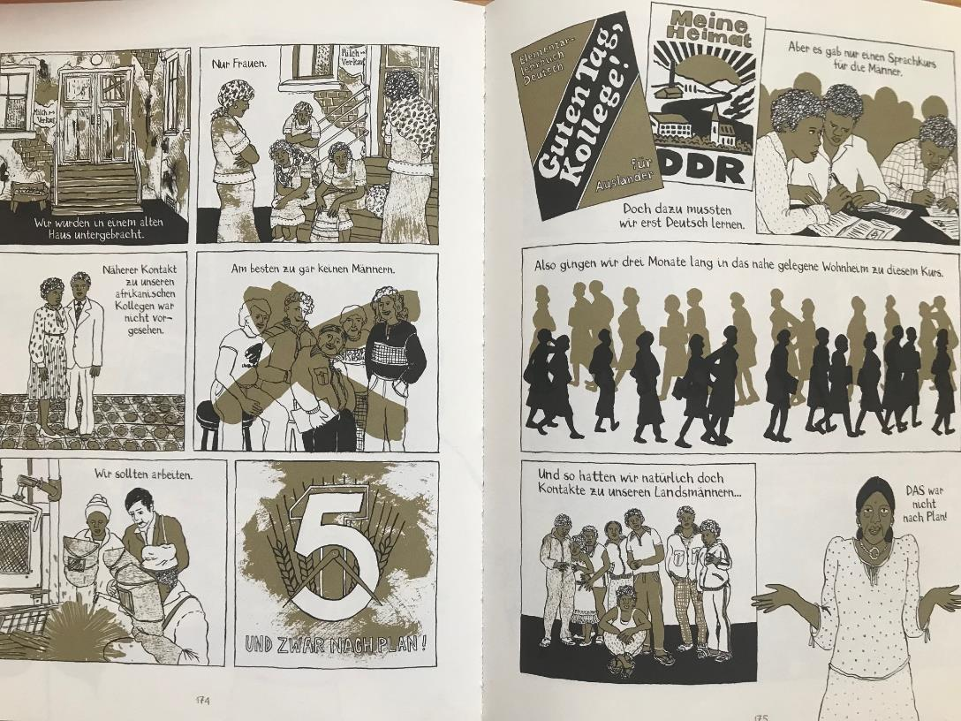
Sharing translations
Notes:
Opportunity for students to share translations and discuss as a whole class or, if more appropriate, to discuss the aspects they found most challenging/stimulating to translate and/or the issues raised by the text. Students could be asked what other issues might be raised by the background information or text. This would be good to explore in a further lesson or workshop.
Examples of issues raised: slave labour, racism, sexism, injustice, colonialism, civil war, migration, human rights, marginalisation, identity, sense of belonging….what you might lose in translation, and how different cultures use language in diverse ways.

Slide 23
Presentation © Queen’s College Translation Exchange 2023
Designed by Clare Savory

