Slide 1


The Areas of Research Interest for Languages Researchers
OPEN Leaders Project
Dr. Charlotte Ryland
Marie Martine
15 July 2025

Slide 2


The Areas of Research Interest
What are the ARIs - Short overview
What are the ARIs – Things to keep in mind
Engaging with the ARIs – Navigating the platform
Engaging with the ARIs – How the ARIs are formulated
Engaging with the ARIs – First Contact
Communicating your research
Making the case for languages research

Slide 3

What are the ARIs? – A short overview
Research questions or topics which government organisations would welcome more research on to inform their policies
Call for ARIs in 2015 - first ARIs published in 2017
Today, 26 government organisations have published ARIs, with ARI database launched in 2023
ARIs are compiled by analytical or science teams within government organisations, in collaboration with policy teams
The Government Office for Science (GOS) - supporting the Government Chief Scientific Adviser (GCSA) – manages the policy for ARIs

Slide 4

ARIs - Things to keep in mind
The ARIs Process
Organisations do not publish everything (omission / vague formulations for sensitive and/or contentious topics)
Organisations engage differently with researchers
Range of activities linked to ARIs
Policy World and Its Constraints
Financial constraints
Time constraints
Political context
A Policy Engagement Tool
The ARIs are conversations starters
The ARIs are a knowledge exchange tool on long-term priorities
Effective tool to scan current issues and frame current and future research

Slide 5
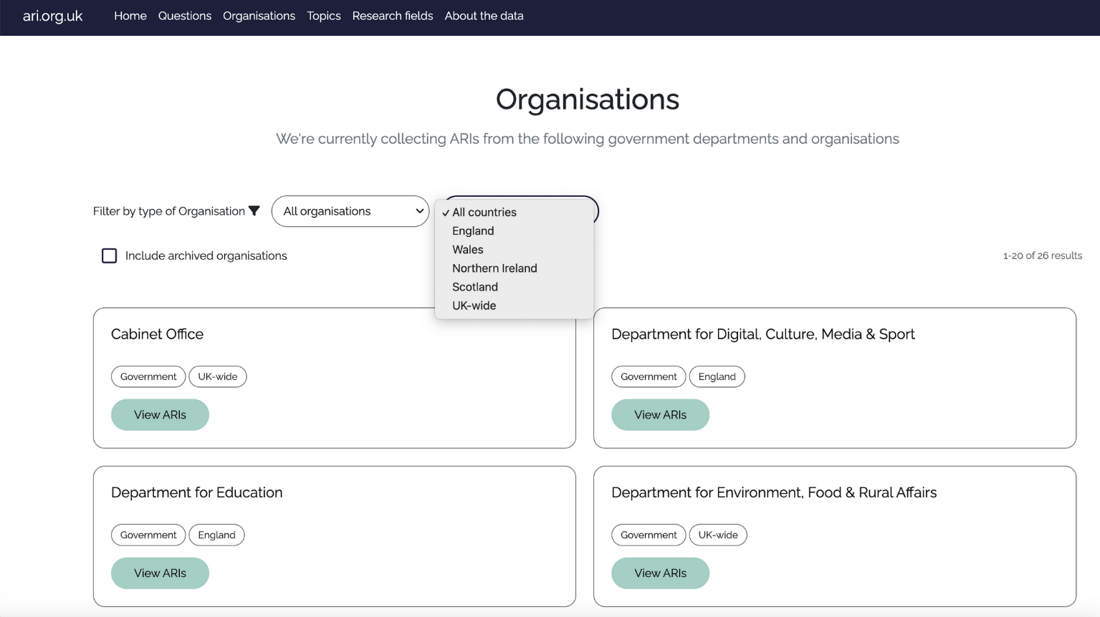
Navigating the platform - by organisations

Slide 6
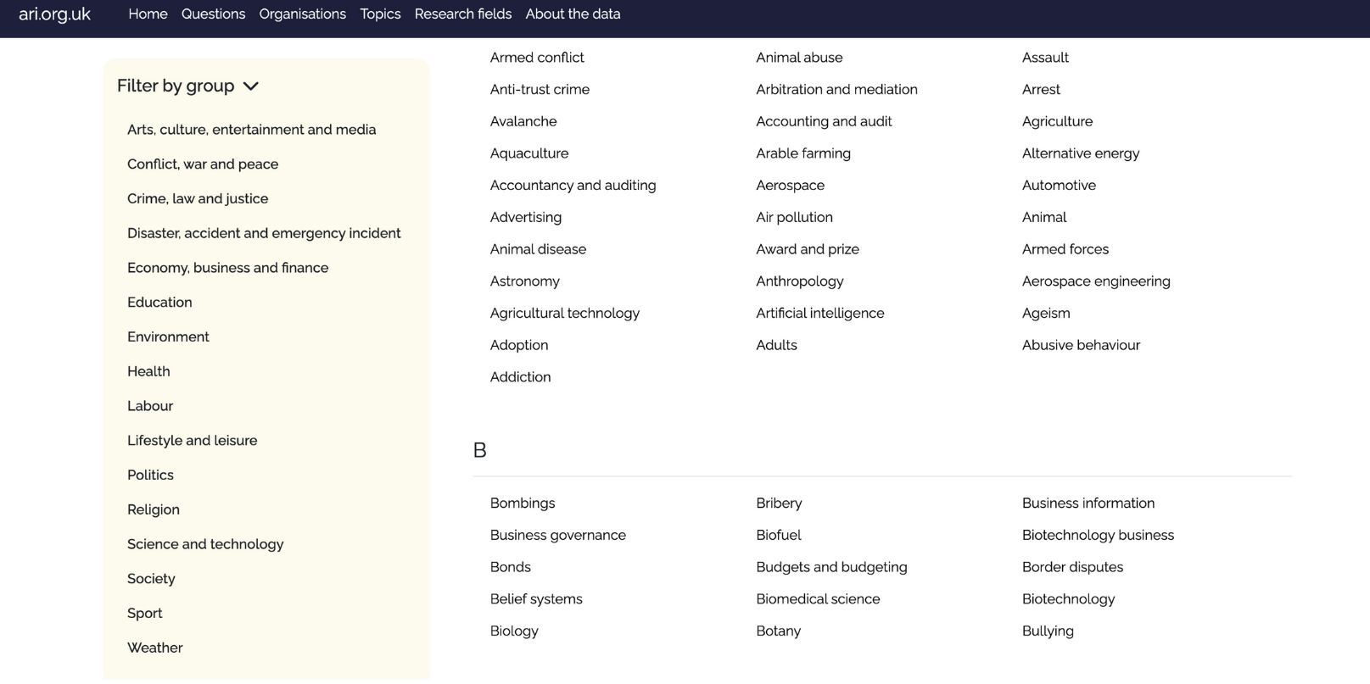
Navigating the platform - by topics

Slide 7
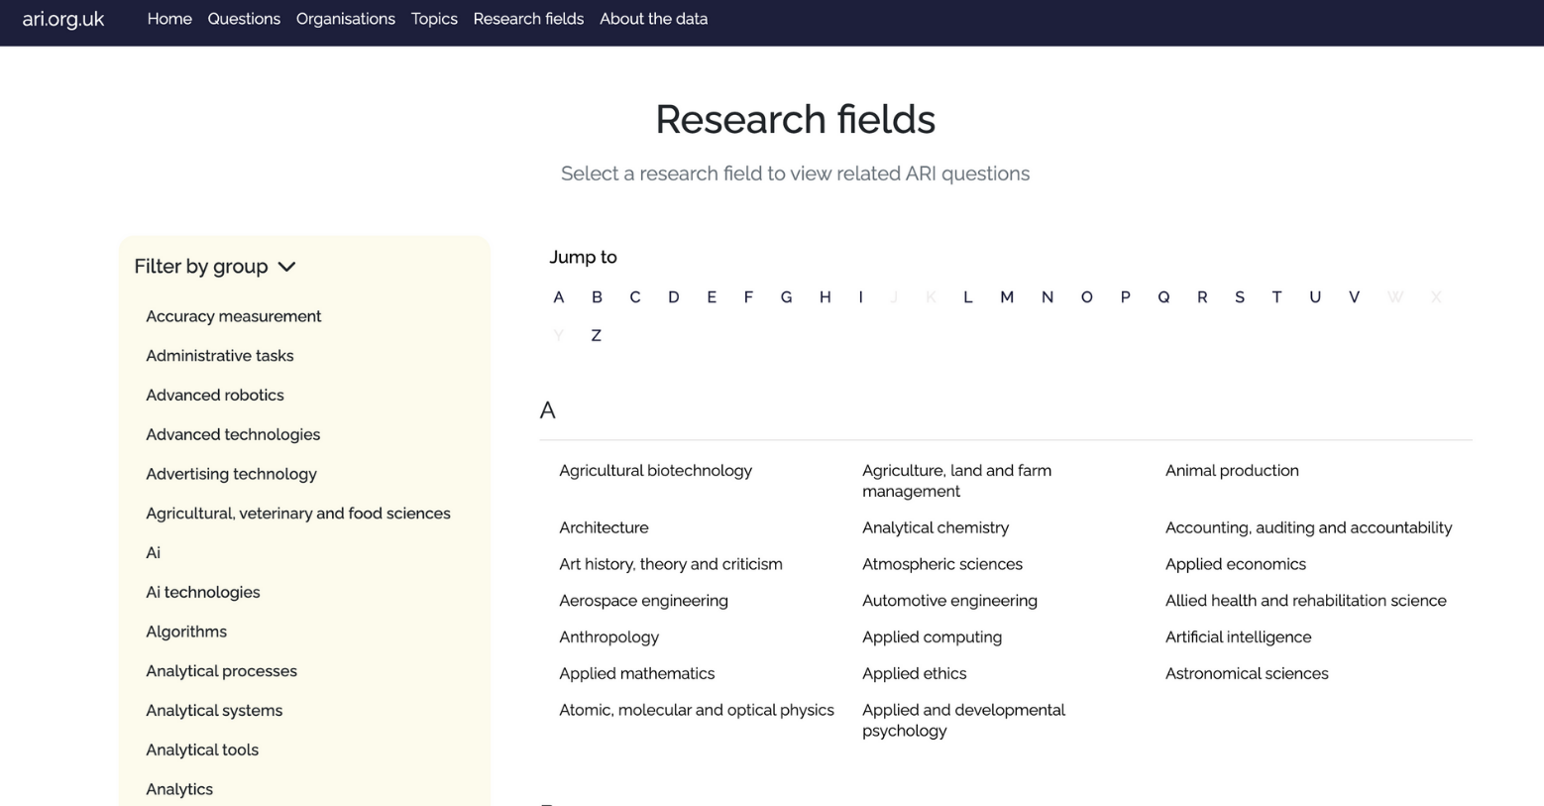
Navigating the platform - by research fields

Slide 8
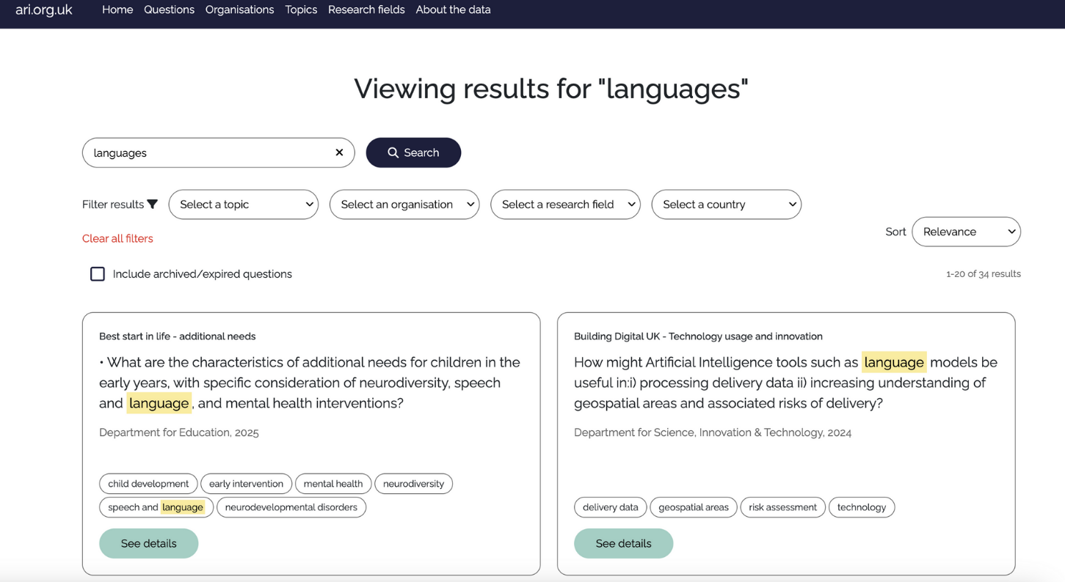
Navigating the platform - word search

Slide 9
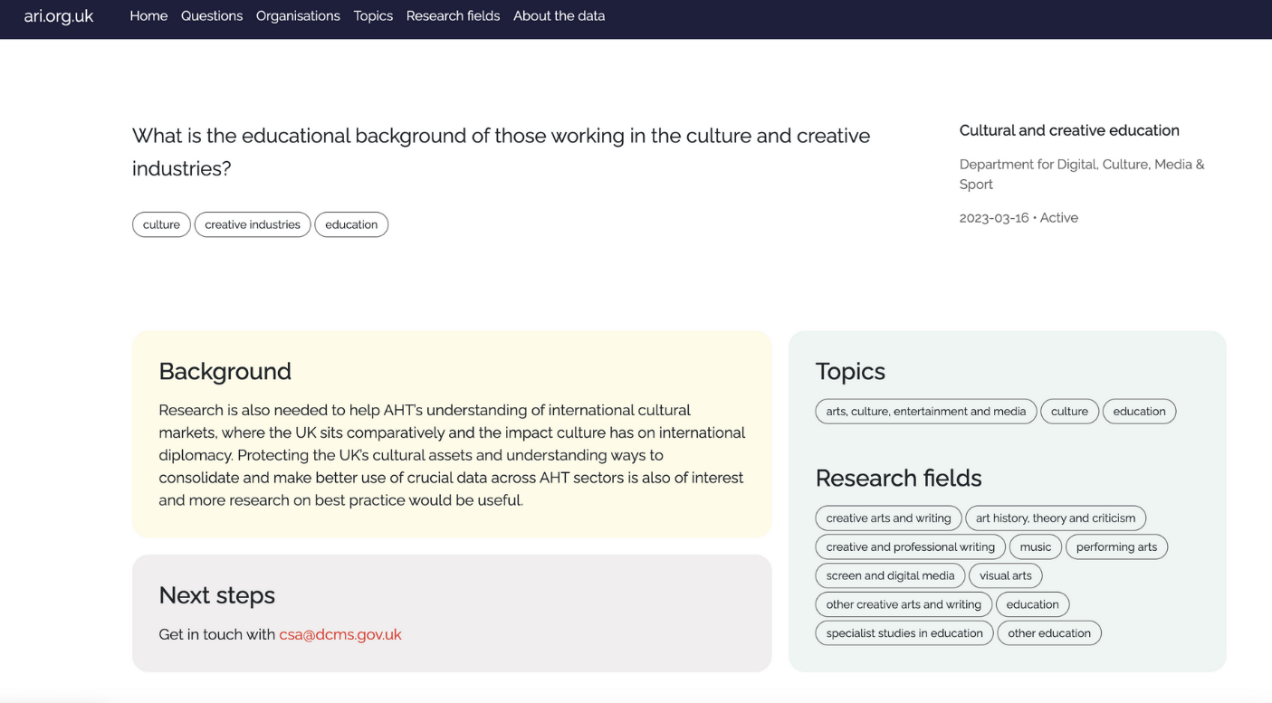
Navigating the platform - a concrete example

Slide 10
Navigating the platform - a concrete example
Question group
The question
The organisation
Framing of the question
Contact details

Slide 11
Analyse and quantify... / Define and measure / analyse and explain
How...?
How can we best learn from X / What can we learn from
How does X affect Y?
Action Verbs
Cause and Effect
Understanding X
Is there a link between X and Y?
HOW THE CURRENT ARIS ARE FORMULATED
How can we best develop...
What factors influence...
Which are the most effective strategies to...
What is the best evidence for...
Impact
Evidence
What are the impacts of
What are the notable gaps in...
What works for....
What are the challenges and issues facing...
What are the benefits and opportunities of...
What are the barriers to and/or drivers of...

Slide 12
How current ARIs are framed - the government’s five priorities
01
02
03
Kickstart economic growth
Build an NHS fit for the future
Safer streets
04
05
Break down the barriers to opportunity
Make Britain a clean energy superpower
https://www.gov.uk/missions
Notes:
Here talk briefly about DfE and MHCLG

Slide 13

Responding to ARIs - First Contact
Email address provided on specific ARI’s page – Things to mention:
Your organisation, role, career stage
What your research is about – what you found – what you recommend
How you would like to engage → events, provide evidence, collaborating on new research etc.
ARI teams welcome researchers reaching out before they can provide complete findings.

Slide 14
Communicating your research
Concise and clear communication
Impact-focused; data-driven (can be qualitative); actionable
Provide evidence and potential recommendations
Make UK-relevance clear (but note that some departments are interested in international research)​
Situate your research within the wider picture and link it to the organisation’s priorities

Slide 15
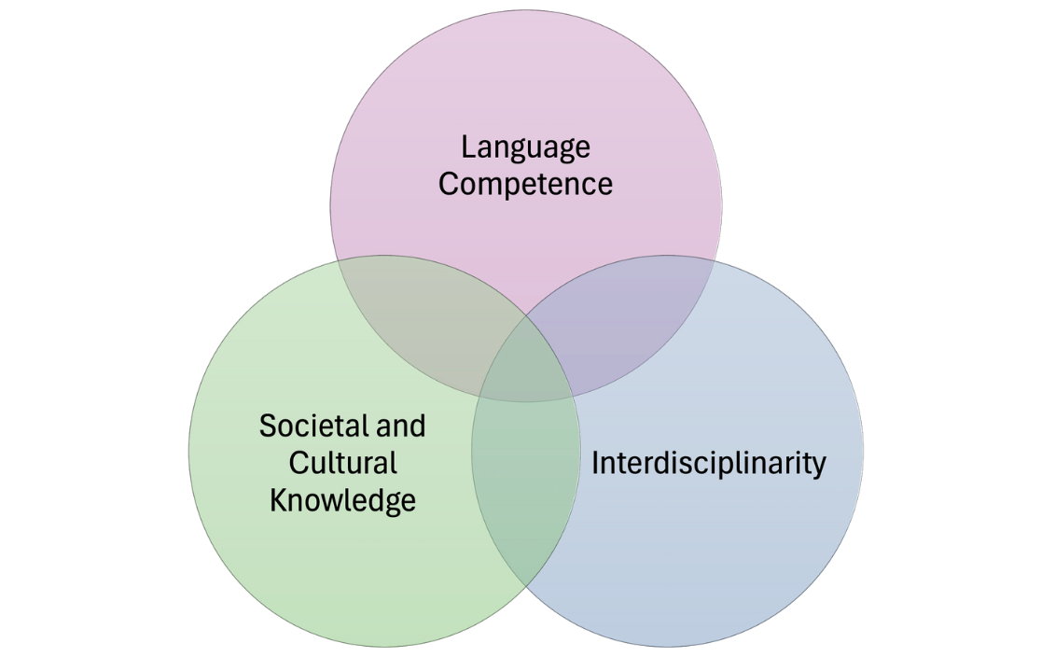
How can language(s) expertise contribute to policy?

Slide 16

Group discussions
Current ARIs divided into five topics: culture — wellbeing — growth — communities — access
How do these questions relate to languages research?
How would you tweak them to integrate a languages’ perspective?

Slide 17

Group 1 - Culture
Cultural and social value of creative industries activities and effects on wellbeing [Department for Digital, Culture, Media and Sport]
How does participation in the creative industries, and in creative activities, affect individuals’ wellbeing and performance? [https://ari.org.uk/aris/140140]
How does creative content affect cultural identity at both the national and local level? [https://ari.org.uk/aris/140138]
Opportunities and impact of international cultural diplomacy, cultural heritage protection [Department for Digital, Culture, Media and Sport]
How does culture drive soft power and what methodologies can be applied/developed to measure the generation of soft power through international cultural engagement? [https://ari.org.uk/aris/139846]

Slide 18
Group 2 - Wellbeing
Extent and costs of loneliness [Department for Digital, Culture, Media and Sport]
How widespread is loneliness? [https://ari.org.uk/aris/139976]
What are the benefits of reducing loneliness? [https://ari.org.uk/aris/139982]
Ending/Tackling homelessness [Ministry of Housing, Communities and Local Government]
What support do children and victims of domestic abuse living in temporary accommodation and domestic abuse safe accommodation need and to what extent is this being delivered? [https://ari.org.uk/aris/723947]

Slide 19
Group 3 - Wellbeing
Extent and cost of loneliness [Department for Digital, Culture, Media and Sport]
What works in reducing loneliness and what are the challenges and opportunities? [https://ari.org.uk/aris/139984]
Enable disabled people and people with health conditions to start, stay, and succeed in work, and get financial support [Department for Work and Pension]
How is disability changing over time? What is the role of the benefit system in this change? [https://ari.org.uk/aris/242324]
Ending/Tackling homelessness [Ministry of Housing, Communities and Local Government]
What are the monetised economic, social and fiscal costs of homelessness and rough sleeping for different groups in the short, medium and long term? [https://ari.org.uk/aris/723941]

Slide 20
Group 4 - Communities
Migration and borders – Refugees [Home Office]
Supporting those who are admitted, both for their own and for wider benefit. [https://ari.org.uk/aris/17264]
Provide a transparent and efficient court system (Victims and witnesses) [Ministry of Justice]
What are the needs and experiences of victims, defence witnesses, and those in distressing civil, family, or tribunal cases? How does this vary by protected characteristics, socio-economic or socio-demographic background and jurisdiction? [https://ari.org.uk/aris/17614]
How prevalent is repeat victimisation and who does it affect? What is the overlap between being a victim and committing an offence, and how does this vary by, for example, crime type and demographic characteristics? [https://ari.org.uk/aris/17618]

Slide 21
Thank you!
Please contribute to our report by filling this feedback form

Slide 22
Resources - Policy Engagement
Wendy Ayres-Bennett, 'Languages and Policy: Building Collaborations between Academics and Policymakers'
All Party Parliamentary Group on Modern Languages - a cross-party alliance of MPs with interest in promoting languages
Languages, Society and Policy – A journal connecting research in linguistics and languages, cultures and societies with policy and the public
Charles Forsdick, ‘‘Translating Cultures’, Translating Research’
Arlene Holmes-Henderson, ‘Engaging with policymakers as a researcher in the Arts and Humanities: a guide to how, what and why’.
AHRC guide to policy engagement for humanities researchers
How to engage with policy makers: A guide for academics in the arts and humanities (more detailed guide than the above, by the Institute for Government). Further guides by the IFG can be found here.
Introduction to Policy Engagement and ‘how to’ Guide for Researchers by the University of Cambridge
Research to policy impact: strategies for translating findings into policy messages, University of Oxford
Charlotte Wood (Chartered Institute for Public Relations), ‘Communicating Evidence to Policy Makers – What works best?’
Guidance by the Parliament
CAPE Guide ‘The Art of the Possible: Catalysts, Collaborations and Capabilities in Academic-Policy Engagement’
https://www.queens.ox.ac.uk/engaging-with-public-policy/

Slide 23
Resources - Areas of Research Interest
The ARI database: https://ari.org.uk/
Kathryn Oliver and Annatte Boaz (Transforming Evidence), ‘How can people use ARIs most productively?’ (2025)
Kathryn Oliver, Annette Boaz, Giulia Cuccato, ‘Areas of research interest: joining the dots between government and research at last?’ (2022)
Michael Salmon, ‘Behind the scenes of the government’s areas for research interest’ (2024)
Annette Boaz and Kathryn Oliver, ‘How well do the UK government’s ‘areas of research interest’ work as boundary objects to facilitate the use of research in policymaking?’, Policy and Politics, 51:2 (2023)
Charlotte Pell, Charlotte Campbell, Rob Davies, ‘From Many Flowers to a Regional Ecosystem: The Future of Place-Based ARIs’, UPEN (2025)
Max French and Melissa Hawking (CAPE), Areas of Research Interest. A Practical Guide (2024)
Government Office for Science, Writing and using Areas of Research Interest (2024)

